Slide 1
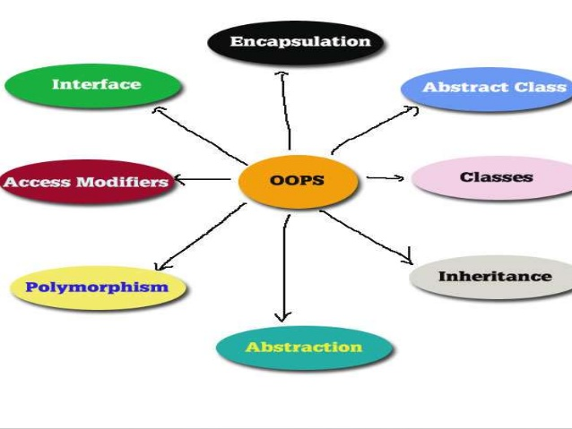
Object Oriented Programming & Design
Session – 6: 2-Dec-2018
Notes:
NOTE:
To change the image on this slide, select the picture and delete it. Then click the Pictures icon in the placeholder to insert your own image.

Slide 2

Agenda
Assignment Discussion
Interfaces
  What is an Interfaces
  Designing Interfaces
  Extending & Implementing
  Comparable & Comparator
Nested Classes
  What are Nested Classes
  Inheriting Nested Classes & Interfaces
  Inner Classes
  Anonymous Inner Classes
Exception Handling

Slide 3

Assignment
Due on 20-Jan-2019

Slide 4
Assignment Instructions
What you need to do?
1.Given below are various topics and desired outputs. Each group is to choose a topic of their liking.
2.Every member has to submit the assignment, mentioning the area which they had worked
3.Design the solution. The solution should be designed using OOP concepts, such that your final artifacts should contain classes & interfaces to execute the programs
4.UI is not mandatory, do not spend too much time on designing the UI. Simple command line or console I/P O/P is acceptable.
Artifacts to be submitted:
1.Source Code.
2.Screen Shots of All deliverables

Slide 5
Assignment Instructions
Submission Process
1.Create a zip file of all your code artifacts and screenshots
2.The zip file should be named WIMS_OOPD_<BITSID>.zip.
Any other file name will be difficult as it is not possible to track submissions, hence adhere to the naming convention.
3.Email your assignment to (avadekkedhil@wilp.bits-pilani.ac.in)
Note:
Plagiarism will not be tolerated and will not be considered for evaluation & grading.
My Contact Details are : (avadekkedhil@wilp.bits-pilani.ac.in/9881300394)

Slide 6
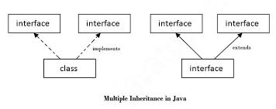
InTERFAceS
Your Window towards modularity

Slide 7
Interfaces in Java
An interface in java is a blueprint of a class. It has static constants and abstract methods only.
An interface is a reference type in Java. It is similar to class. It is a collection of abstract methods. A class implements an interface, thereby inheriting the abstract methods of the interface.
Along with abstract methods, an interface may also contain constants, default methods, static methods, and nested types. Method bodies exist only for default methods and static methods.
Writing an interface is similar to writing a class. But a class describes the attributes and behaviors of an object. And an interface contains behaviors that a class implements.

Slide 8
Interface & Class Similarities
An interface is not a class. Writing an interface is similar to writing a class, but they are two different concepts. A class describes the attributes and behaviors of an object. An interface contains behaviors that a class implements.
An interface is similar to a class in the following ways:
  An interface can contain any number of methods.
  An interface is written in a file with a .java extension, with the name of the interface matching the name of the file.
  The bytecode of an interface appears in a .class file.
  Interfaces appear in packages, and their corresponding bytecode file must be in a directory structure that matches the package name.

Slide 9
Interface & Class Difference
However, an interface is different from a class in several ways, including:
  You cannot instantiate an interface.
  An interface does not contain any constructors.
  All of the methods in an interface are abstract.
  An interface cannot contain instance fields. The only fields that can appear in an interface must be declared both static and final.
  An interface is not extended by a class; it is implemented by a class.
  An interface can extend multiple interfaces.

Slide 10
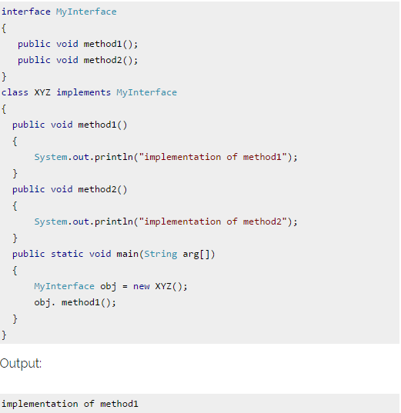
Interface & Class Example

Slide 11
Interface Why do we need them?
Interfaces are used for abstraction.
  Since methods in interfaces do not have body, they have to be implemented by the class before you can access them. The class that implements interface must implement all the methods of that interface.
Interfaces are used to derive multiple inheritance,
  Java programing languages does not allow for multiple inheritance, however using interfaces we can achieve this as a class can implement more than one interfaces, however it cannot extend more than one classes.
Interface is more like a guarantee, the onus of realizing the interface is left to the class which implements it.
  Interfaces have many uses and benefits. For example, an interface can be used to expose certain behaviors of a class, without exposing all of the behaviors of a class. Interfaces can be used to force behavior on other objects, ensuring that certain methods are implemented by an object.
  Interfaces can be used for polymorphism reasons, since an object can take on the form of an interface type.

Slide 12
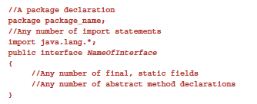
Declaring Interface
The interface keyword is used to declare an interface. The source code file for an interface has the format shown here:

Slide 13
Interface Properties
Interfaces have the following properties:
  An interface is implicitly abstract. You do not need to use the abstract keyword when declaring an interface (although it is acceptable to use it).
  Each method in an interface is also implicitly abstract, so the abstract keyword is not needed. You can explicitly declare a method in an interface as abstract, but typically the abstract keyword is left off.
  Methods in an interface are implicitly public. It is common practice to use the public keyword when writing an interface, but if you do not explicitly declare a method in an interface as public, it will be public anyway.
The Java API contains hundreds of interfaces. For example, the following Runnable interface is defined in the java.lang package.
The Runnable interface is used when writing multithreaded applications.
The design of threads in Java requires a class to implement Runnable to be a thread, thereby forcing the class to have a run() method.
When the thread is started, the run() method is invoked.

Slide 14
Implementing an Interface
When a class implements an interface, you can think of the class as signing a contract, agreeing to perform the specific behaviors of the interface. If a class does not perform all the behaviors of the interface, the class must declare itself as abstract.
More specifically, when a class implements an interface, the class has two options:
  Implement all of the methods in the interface
  Be declared as abstract
A class uses the implements keyword to implement an interface. The implements keyword appears in the class declaration following the extends portion of the declaration. The format for implements looks similar to:
public class ClassName extends ParentClassName implements InterfaceName

Slide 15
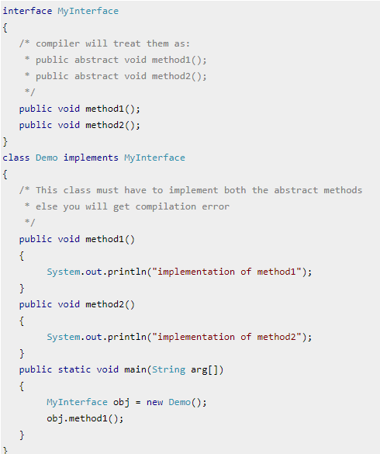
Interface Examples
This is how a class implements an interface.
It has to provide the body of all the methods that are declared in interface or in other words you can say that class has to implement all the methods of interface
Do You Know class implements interface but an interface extends another interface

Slide 16
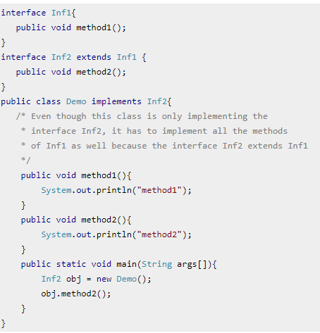
Extending Interface Examples
This is how a class implements an interface.
It has to provide the body of all the methods that are declared in interface or in other words you can say that class has to implement all the methods of interface
Do You Know class implements interface but an interface extends another interface

Slide 17
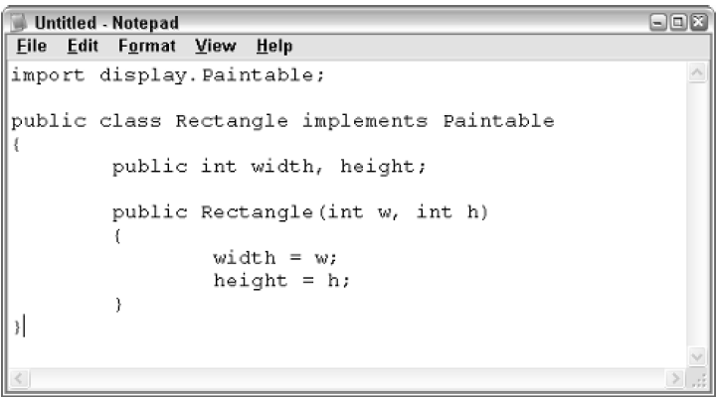
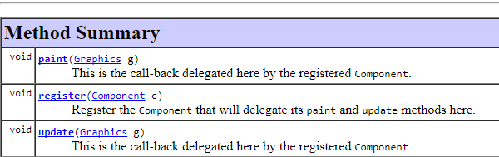
Implementing Interface Examples
Will create a class that will implement an interface called Paintable
So What is the Problem here?
Methods of Interface Paintable

Slide 18
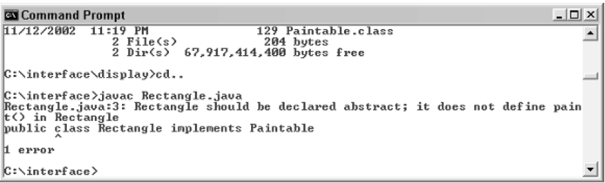
Implementing Interface Examples
Will create a class that will implement an interface called Paintable
Notice that the Rectangle class declares that it implements Paintable, but it
does not contain the paint() method
Methods of Interface Paintable

Slide 19
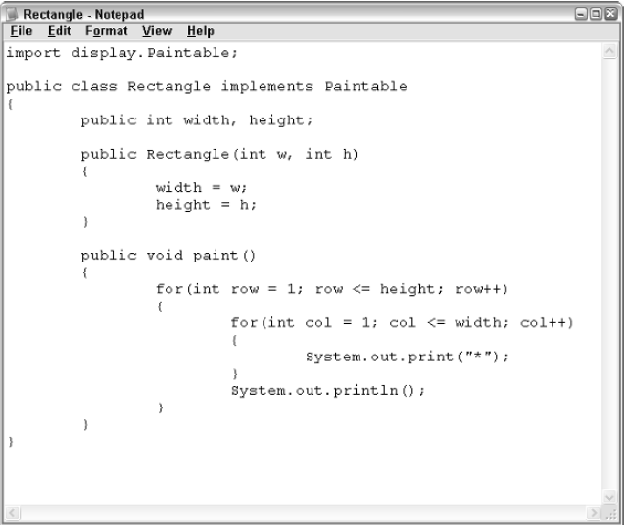
Implementing Interface Examples
Will create a class that will implement an interface called Paintable
Correct Implementation of an interface with the paint method described.

Slide 20
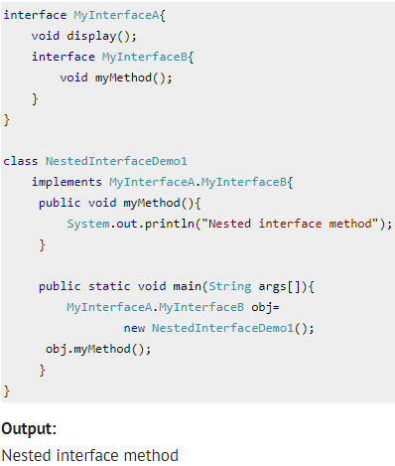
Nested Interfaces
An interface which is declared inside another interface or class is called nested interface.
They are also known as inner interface.
Since nested interface cannot be accessed directly, the main purpose of using them is to resolve the namespace by grouping related interfaces (or related interface and class) together.
This way, we can only call the nested interface by using outer class or outer interface name followed by dot( . ), followed by the interface name.

Slide 21
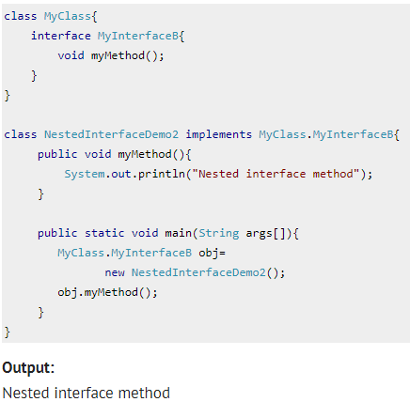
Nested Interfaces - Class
An interface which is declared inside another interface or class is called nested interface.
They are also known as inner interface.
Since nested interface cannot be accessed directly, the main purpose of using them is to resolve the namespace by grouping related interfaces (or related interface and class) together.
This way, we can only call the nested interface by using outer class or outer interface name followed by dot( . ), followed by the interface name.

Slide 22
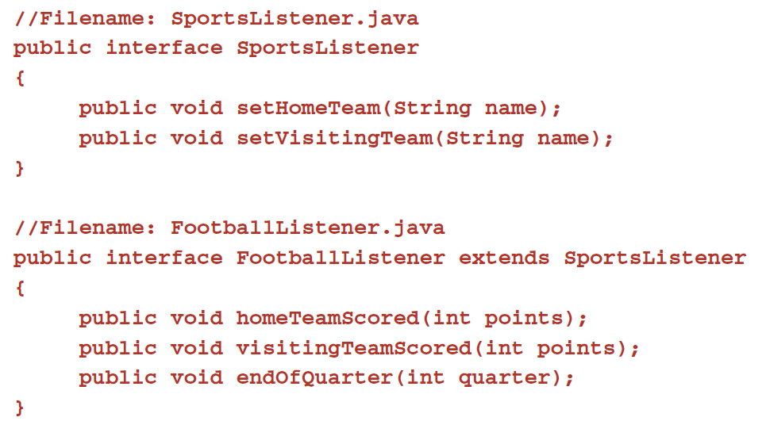
Extending Interfaces
An interface can extend another interface, similarly to the way that a class can extend another class.
The extends keyword is used to extend an interface, and the child interface inherits the methods of the parent interface.
The following SportsListener interface is extended by HockeyListener and
FootballListener interfaces.

Slide 23
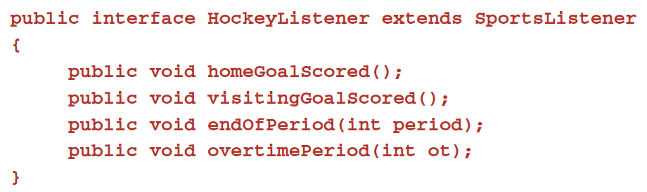
Extending Interfaces
The HockeyListener interface has four methods, but it inherits two from SportsListener;
thus, a class that implements HockeyListener needs to implement all six methods.
Similarly, a class that implements FootballListener needs to define the three methods from FootballListener and the two methods from SportsListener.

Slide 24
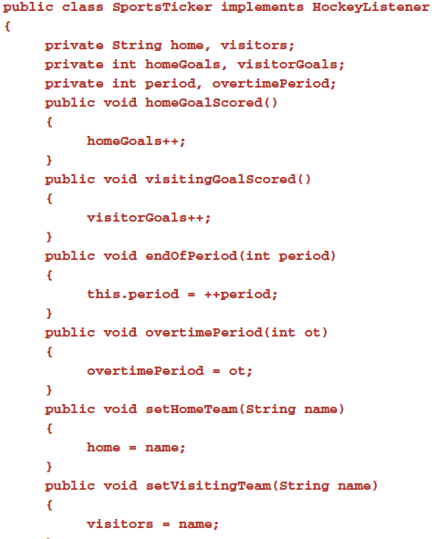
Extending Interfaces
The following SportsTicker class implements the HockeyListener interface.
Notice that the required six methods are defined to avoid declaring Sports-Ticker abstract.

Slide 25
Extending Multiple Interface
In Java, a class can only extend one parent class. (Multiple inheritance is not allowed.) Interfaces are not classes, however, and an interface can extend more than one parent interface. The extends keyword is used once, and the parent interfaces are declared in a comma-separated list.
For example, if the HockeyListener interface extended both SportsListener and EventListener, it would be declared as:
  public interface HockeyListener extends SportsListener, EventListener
Any class that implements this HockeyListener interface must implement all the methods in HockeyListener, SportsListener, and EventListener.

Slide 26
Tag or Marker Interface
The most common use of extending interfaces occurs when the parent interface does not contain any methods. For example, the MouseListener interface in the java.awt.event package extended java.util.EventListener, which is defined as:
    package java.util;
    public interface EventListener
    {}
An interface with no methods in it is referred to as a tagging interface. Why define an interface with no methods in it? Well, there are two basic design purposes of tagging interfaces:
Creates a common parent. As with the EventListener interface, which is extended by dozens of other interfaces in the Java API, you can use a tagging interface to create a common parent among a group of interfaces. For example, when an interface extends EventListener, the JVM knows that this particular interface is going to be used in an event delegation scenario.
Adds a data type to a class. This situation is where the term tagging comes from. A class that implements a tagging interface does not need to define any methods (since the interface does not have any), but the class becomes an interface type through polymorphism.

Slide 27
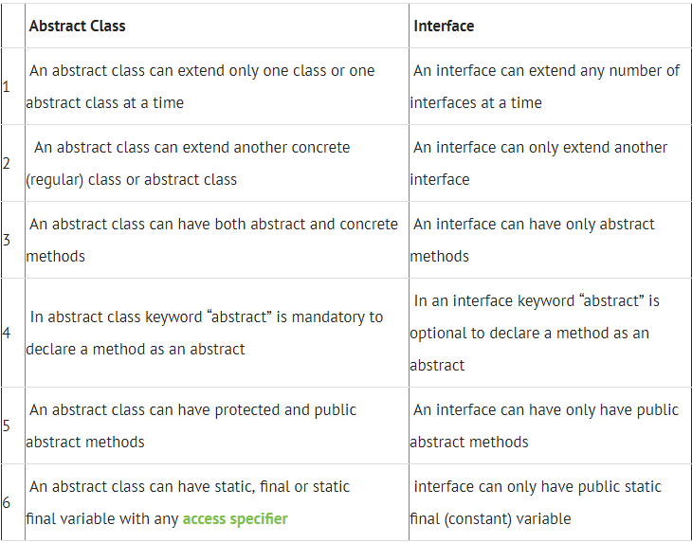
Interface vs Abstract Class

Slide 28
Interfaces Recap
Harnessing Chi

Slide 29
Interfaces in Java
An interface in java is a blueprint of a class. It has static constants and abstract methods only.
An interface is a reference type in Java. It is similar to class. It is a collection of abstract methods. A class implements an interface, thereby inheriting the abstract methods of the interface.
Along with abstract methods, an interface may also contain constants, default methods, static methods, and nested types. Method bodies exist only for default methods and static methods.
Writing an interface is similar to writing a class. But a class describes the attributes and behaviors of an object. And an interface contains behaviors that a class implements.

Slide 30
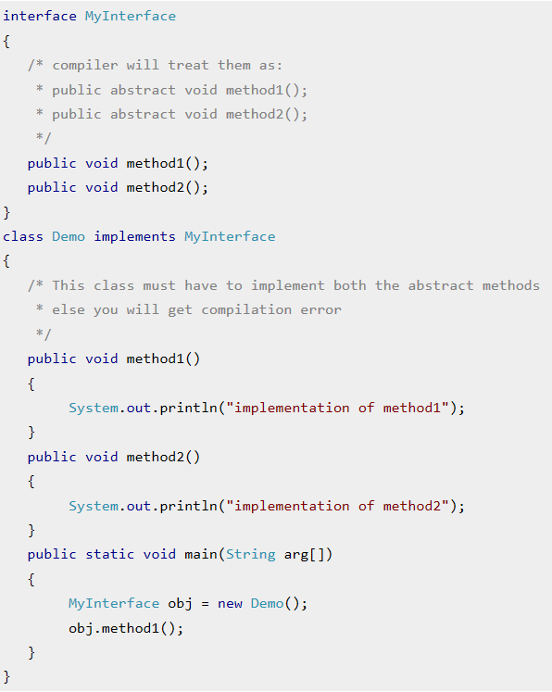
Interface Key Points to Remember
Here are the key points to remember about interfaces:
1) We can’t instantiate an interface in java. That means we cannot create the object of an interface
2) Interface provides full abstraction as none of its methods have body. On the other hand abstract class provides partial abstraction as it can have abstract and concrete(methods with body) methods both.
3) implements keyword is used by classes to implement an interface.
4) While providing implementation in class of any method of an interface, it needs to be mentioned as public.
5) Class that implements any interface must implement all the methods of that interface, else the class should be declared abstract.
6) Interface cannot be declared as private, protected or transient.
7) All the interface methods are by default abstract and public.
8) Variables declared in interface are public, static and final by default.

Slide 31
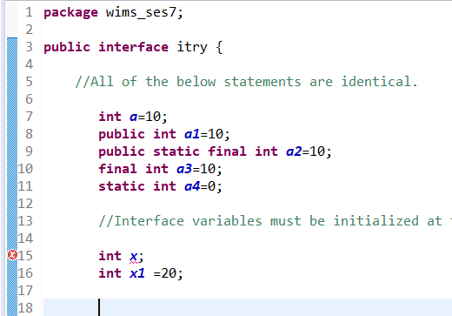
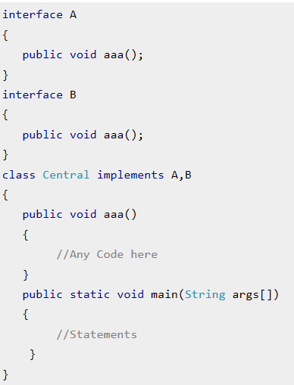
Interface Key Points to Remember
Interface variables must be initialized at the time of declaration otherwise compiler will throw an error.
Inside any implementation class, you cannot change the variables declared in interface because by default, they are public, static and final.
If there are two or more same methods in two interfaces and a class implements both interfaces, implementation of the method once is enough.
A class cannot implement two interfaces that have methods with same name but different return type.
Variable names conflicts can be resolved by interface name.

Slide 32
Nested Interface
Harnessing Chi

Slide 33
Nested Interfaces
An interface which is declared inside another interface or class is called nested interface.
They are also known as inner interface.
Since nested interface cannot be accessed directly, the main purpose of using them is to resolve the namespace by grouping related interfaces (or related interface and class) together.
This way, we can only call the nested interface by using outer class or outer interface name followed by dot( . ), followed by the interface name.

Slide 34
Nested Interface – In Class
We can declare interfaces as member of a class or another interface.
Such an interface is called as member interface or nested interface.
Interface in a class
Interfaces (or classes) can have only public and default access specifiers when declared outside any other class.
This interface declared in a class can either be default, public, protected not private.
While implementing the interface, we mention the interface as c_name.i_name where c_name is the name of the class in which it is nested and i_name is the name of the interface itself

Slide 35
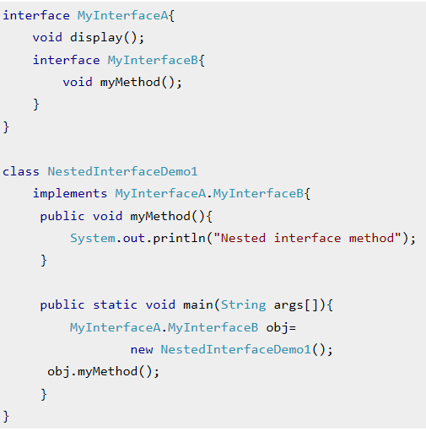
Nested Interface – In Interface
We can declare interfaces as member of another interface.
Such an interface is called as member interface or nested interface.
Interface in a Interface
An interface can be declared inside another interface also.
We mention the interface as i_name1.i_name2 where i_name1 is the name of the interface in which it is nested and i_name2 is the name of the interface to be implemented.

Slide 36
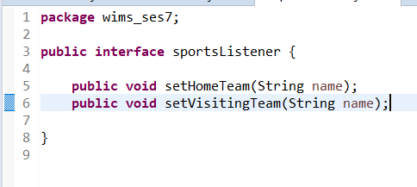
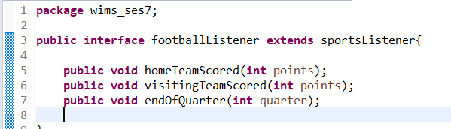
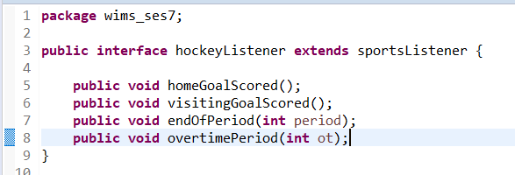
Extending Interfaces
An interface can extend another interface, similarly to the way that a class can extend another class.
The extends keyword is used to extend an interface, and the child interface inherits the methods of the parent interface.
The following SportsListener interface is extended by HockeyListener and FootballListener interfaces.
The HockeyListener interface has four methods, but it inherits two from SportsListener; thus, a class that implements HockeyListener needs to implement all six methods.
Similarly, a class that implements FootballListener needs to define the three methods from FootballListener and the two methods from SportsListener

Slide 37
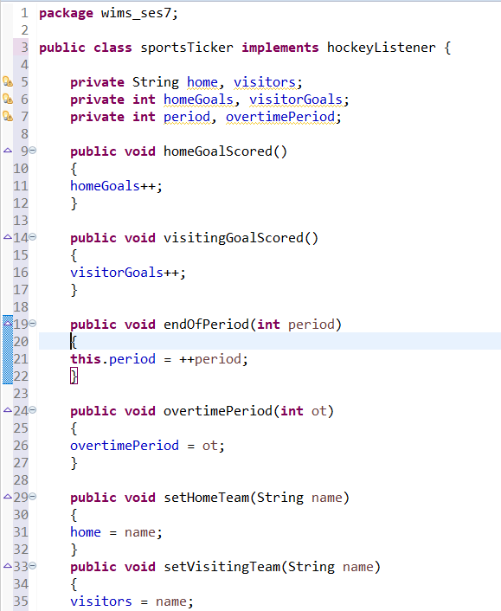
Extending Interfaces
The following SportsTicker class implements the HockeyListener interface.
Notice that the required six methods are defined to avoid declaring Sports-Ticker abstract.

Slide 38
Extending Multiple Interface
In Java, a class can only extend one parent class. (Multiple inheritance is not allowed.) Interfaces are not classes, however, and an interface can extend more than one parent interface. The extends keyword is used once, and the parent interfaces are declared in a comma-separated list.
For example, if the HockeyListener interface extended both SportsListener and EventListener, it would be declared as:
  public interface HockeyListener extends SportsListener, EventListener
Any class that implements this HockeyListener interface must implement all the methods in HockeyListener, SportsListener, and EventListener.

Slide 39
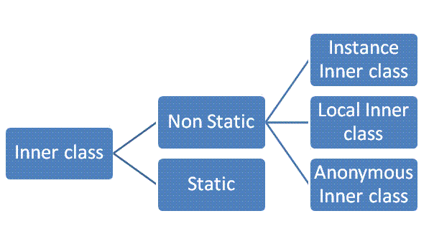
Inner Classes
Finding Inner Peace

Slide 40
Inner classes
Inner class are defined inside the body of another class (known as outer class).
These classes can have access modifier or even can be marked as abstract and final.
Inner classes have special relationship with outer class instances.
This relationship allows them to have access to outer class members including private members too.
Inner classes are of four types depending on how and where you define them. They are −
  Inner Class
  Method-local Inner Class
  Anonymous Inner Class
  Static Nested Class
Notes:
Inner classes are classes which are contained within other classes.
Inner classes has access to all memebrs of the outer class, hence advantageous where you want to have a class defined as private yet access modifies of the outer class which are private.

Slide 41
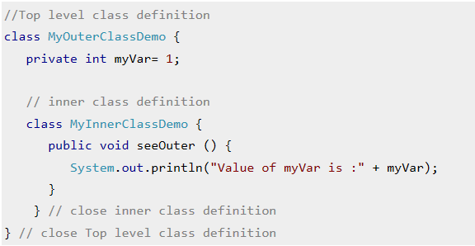
Inner classes
Creating an inner class is quite simple. You just need to write a class within a class.
Unlike a class, an inner class can be private and once you declare an inner class private, it cannot be accessed from an object outside the class.
Inner class acts as a member of the enclosing class and can have any access modifiers: abstract, final, public, protected, private, static.
Inner class can access all members of the outer class including those marked private as shown in the above example where inner class is accessing the private variable "myVar" of outer class.

Slide 42
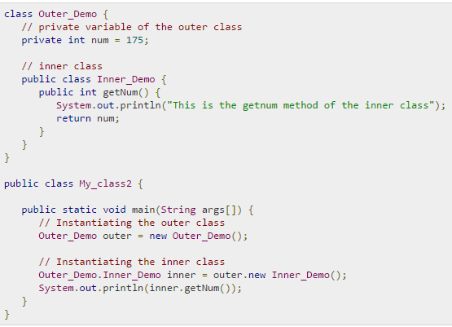
Accessing Private Values
As mentioned earlier, inner classes are also used to access the private members of a class.
Suppose, a class is having private members to access them. Write an inner class in it, return the private members from a method within the inner class, say, getValue(), and finally from another class (from which you want to access the private members) call the getValue() method of the inner class.
To instantiate the inner class, initially you have to instantiate the outer class. Thereafter, using the object of the outer class, following is the way in which you can instantiate the inner class.
Notes:
Talk about defining a method in the inner class, instantiating the outer class to get access to the private values of the outer class

Slide 43
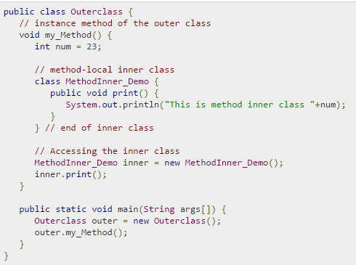
Method-local Inner Class
In Java, we can write a class within a method and this will be a local type.
Like local variables, the scope of the inner class is restricted within the method.
A method-local inner class can be instantiated only within the method where the inner class is defined.
The following program shows how to use a method-local inner class.
Notes:
Method local IC’s are IC which are defined within the method. Till 1.7 JDK, this could not access not final local variables, which has been changed from JDK 1.8 onwards

Slide 44
Method-local Inner Class
Local inner classes are local to code blocks, such as a method body, constructor, or initialization block and can be used within the same code block they were defined in.
Local inner classes also called method local inner classes are not members of the class of which the code is a part but are local to the code block they belong to, just as a local variable.
Local inner classes cannot be accessed outside the block in which they are defined.
Instances of local inner classes are normal objects that can be passed as arguments and returned from methods, and they exist within a valid scope.
For local inner classes are local to a code block, they cannot have access modifiers. Also, local inner classes cannot be declared static because they are local.
Important point to note is like regular inner class objects, the method local inner class object shares a special relationship with the enclosing class object, and can access outer class's private members as regular inner classes do. But the local inner class object cannot use the local variables of the method in which the local inner class is defined
Notes:
Method local IC’s are IC which are defined within the method. Till 1.7 JDK, this could not access not final local variables, which has been changed from JDK 1.8 onwards

Slide 45
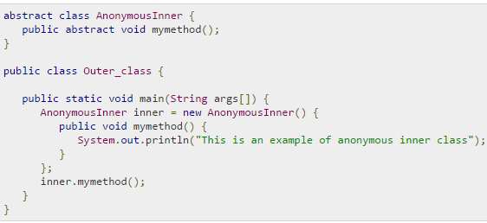
Anonymous Inner Class
An inner class declared without a class name is known as an anonymous inner class.
In case of anonymous inner classes, we declare and instantiate them at the same time.
Generally, they are used whenever you need to override the method of a class or an interface.
The syntax of an anonymous inner class is as follows −
Notes:
Anonymous, as the name suggests, it’s unkown or there is no name. What we do here is write the entire code at the time of invocation, No explicit object reference is created. Useful when you have cases where you need to use a class only once and not for anything else.

Slide 46
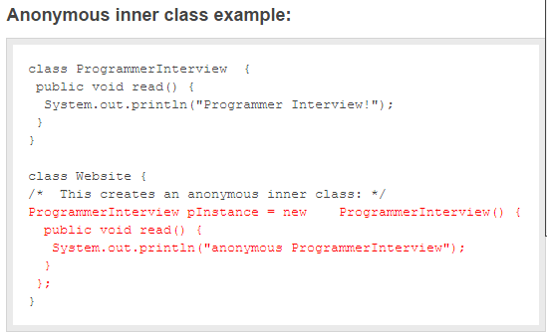
Example: Anonymous Inner Class
Notes:
We use the AIC to impart polymorphisms. The inner class belongs to the inner circle of the outer class, this means that this class will have all access to the both private & public variable of the superclass. There is no object but only a reference handle. To create object use local class.

Slide 47
Why Anonymous Inner Class
Inner classes and anonymous classes are quite commonly used in GUI event handling for example.
It is certainly hard for beginners to visualize situations where you would need them.
At the beginning all you really need to know is that you can use them, and with more experience situations when they are useful will be come more apparent.
There is probably nothing you can do with an inner class that could not be achieved without ever using them but sometime it they do make a much cleaner solution to a problem.
It would probably be a relatively rare situation that you would find the need to use static inner classes.

Slide 48
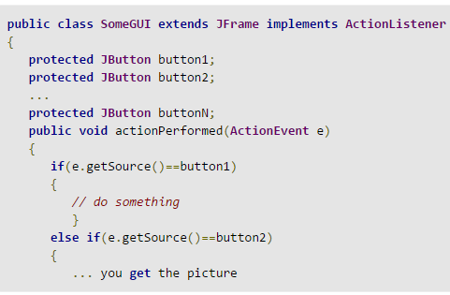
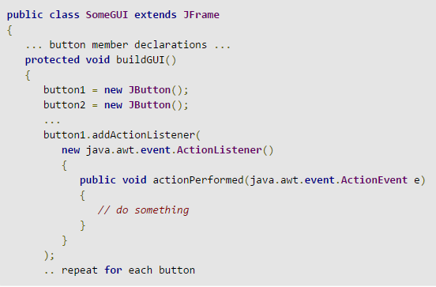
Why Anonymous Inner Class
Monolithic Code Block
Anonymous Inner Class Code Block

Slide 49
Disadvantages
The use of inner classes will also increase the total number of classes in your code.
Moreover, from a development point of view, most Java tools come up a bit short on their support of inner classes.

Slide 50
Difference Between Static Nested & Inner Class
Static nested classes do not directly have access to other members (non-static variables and methods) of the outer class, because as it is static, it must access the non-static members of its enclosing class through an object. That is, it cannot refer to non-static members of its enclosing class directly.
If the nested class does not access any of the variables of the enclosing class, it can be made static. The advantage of this is that you do not need an enclosing instance of the outer class to use the nested class.
Non-static nested classes (inner classes) have access to all members (static and non-static variables and methods, including private) of its outer class and may refer to them directly in the same way that other non-static members of the outer class do. But it can not contain static members

Slide 51
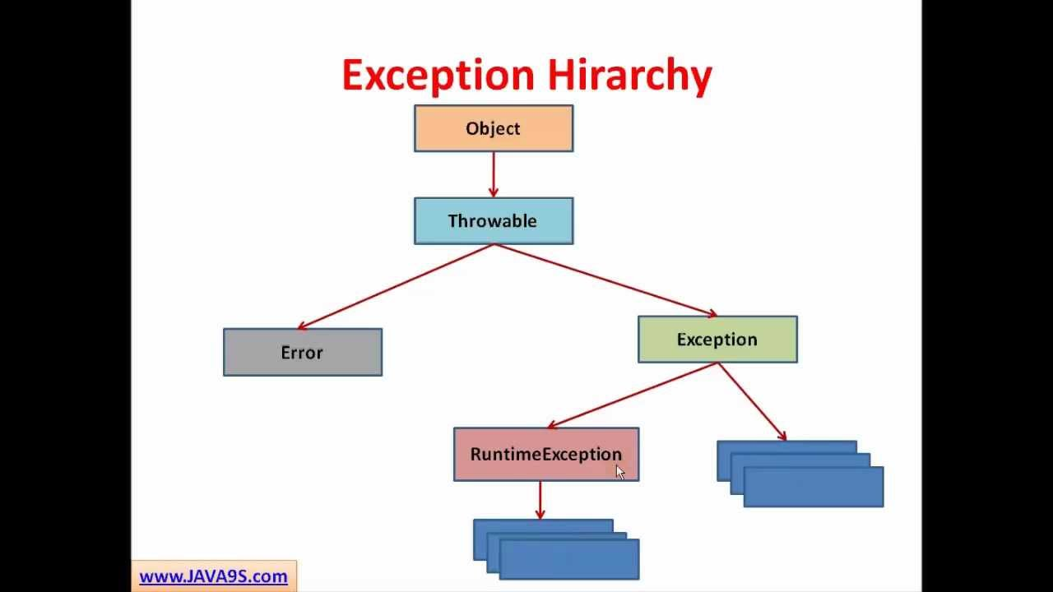
EXCEPTION HANDLING
There is always one contrary to the Rule

Slide 52
Exception Handling
An exception is a problem that arises during the execution of a program.
An exception can occur for many different reasons, including the following: a user has entered invalid data, a file that needs to be opened cannot be found, a network connection has been lost in the middle of communications, or the JVM has run out of memory.
Some of these exceptions are caused by user error, others by programmer error, and others by physical resources that have failed in some manner.
Exception handling is yet another fundamental aspect of Java that must be understood before the more advanced APIs of the language can be used.

Slide 53
Exception Categories
Checked exceptions: A checked exception is an exception that is typically a user error or a problem that cannot be foreseen by the programmer. For example, if a file is to be opened, but the file cannot be found, an exception occurs. Because this type of exception is a checked exception, it must be dealt with in Java and cannot simply be ignored
Runtime exceptions. A runtime exception is an exception that occurs that probably could have been avoided by the programmer. As opposed to checked exceptions, runtime exceptions can be ignored (and should be, in most cases). You should let a runtime exception crash your program, then find the problem and change your code so that the exception does not arise again. Examples of runtime exceptions include running off the end of an array, integer division by zero, referencing a null reference, and casting a reference to an invalid data type.

Slide 54
Exception Categories
Errors. Actually, these are not exceptions at all, but problems that arise beyond the control of the user or the programmer.
Errors are typically ignored in your code because you can rarely do anything about an error, even if you wanted your program to fix the problem.
For example, if a stack overflow occurs, an error will arise.
However, because you are out of memory, your program will be unable to continue executing. Any code you have written that attempts to fix the problem won’t get a chance to execute anyway, so errors are often ignored when designing and writing Java applications.

Slide 55
What Happens during Exception
The runtime system searches the call stack for a method that contains an exception Handler
When an appropriate handler is found, the runtime system passes the exception to the handler.
  An exception handler is considered appropriate if the type of the exception object thrown matches the type that can be handled by the handler.
  The exception handler chosen is said to catch the exception.
● If the runtime system exhaustively searches all the methods on the call stack without finding an appropriate exception handler, the runtime system (and, consequently, the program) terminates and uses the default exception handler

Slide 56
What Happens during Exception
With an exception heading its way, method1() has three choices:
Catch the exception so that it does not go any further down the call stack.
Catch the exception, then throw it back down the call stack.
Not catch the exception, thereby causing method1() to be popped off the call stack, with the exception continuing down the call stack to main().
This flow of control continues down the call stack, no matter how many
methods appear on the call stack. Each method further down the call stack either catches the exception and stops this process, catches the exception and throws it again, or simply does nothing and lets the exception fall through to the next method.
What happens when we reach the bottom of the call stack? Well, if an exception is thrown to main(), then main() had better catch the exception or the program will terminate. When an exception reaches the bottom of a call stack and no method has stopped it along the way, the JVM will crash and inform you of the details of the exception.

Slide 57
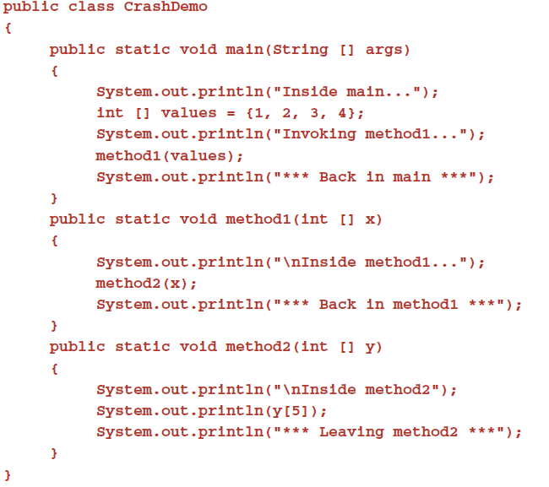
Exception Example
Let’s look at an example of what happens when an exception is ignored all the way down the call stack.
The following CrashDemo program has three methods: main(), method1(), and method2().
Study the program and try to determine what happens when it executes.

Slide 58
Exception Example
The CrashDemo program crashes when an ArrayIndexOutOfBoundsException occurs, which is an example of a runtime exception. Notice from the output of the CrashDemo program that the following statement does not execute in method2():
This exception is thrown by the JVM, which pops method2() off the call stack. Because method1() does not do anything with the exception, method1() is popped off the call stack.
Because main() ignores the exception as well, main() is popped off the call stack.
The exception is then passed on to the JVM, and the JVM prints out the stack trace before terminating. Notice that the stack trace contains useful information, including the line numbers in the source code where the exception occurred.
You can print this stack trace yourself with any exception you catch by using the printStackTrace() method of the Throwable class.

Slide 59
Error vs Exception
Error : An Error “indicates serious problems that a reasonable application should not try to catch.”
Exceptions : An Exception “indicates conditions that a reasonable application might want to catch.
Both Errors and Exceptions are the subclasses of java.lang.Throwable class. Errors are the conditions which cannot get recovered by any handling techniques. It surely cause termination of the program abnormally. Errors belong to unchecked type and mostly occur at runtime. Some of the examples of errors are Out of memory error or a System crash error.
Exceptions are the conditions that occur at runtime and may cause the termination of program. But they are recoverable using try, catch and throw keywords. Exceptions are divided into two catagories : checked and unchecked exceptions. Checked exceptions like IOException known to the compiler at compile time while unchecked exceptions like ArrayIndexOutOfBoundException known to the compiler at runtime. It is mostly caused by the program written by the programmer.

Slide 60
Handle or Declare
Java has a rule that is strictly enforced regarding checked exceptions; it is referred to as the Handle or Declare Rule.
The rule states simply that a checked exception must be either handled or declared.
Handling an exception involves catching the exception.
Declaring an exception involves a method using the throws keyword in its signature, declaring any checked exceptions that the method is not going to handle.
The Handle or Declare Rule does not apply to runtime exceptions.
If you do something in your program that can generate a runtime exception, you have the option of catching that exception or simply ignoring it and letting it crash your program.
As I mentioned earlier, in most cases you do not try to catch runtime exceptions because they are often the result of poor code design. Let them crash your program, then find the problem and fix it.

Slide 61
Throwable Class
The three types of exceptions share a common parent: the java.lang.Throwable class. Only objects of type Throwable can be thrown by the JVM.
The Throwable class has two child classes: Exception and Error.
The inheritance hierarchy of exceptions is based on the three categories. The Error class is the parent class of all Java errors; the Exception class is the parent class of all exceptions, both run time and checked.
Runtime exceptions and checked exceptions are further distinguished by where they fit in the inheritance hierarchy. If a class is a child of Runtime-Exception, this child class represents a runtime exception.

Slide 62
Catching Exceptions
A method catches an exception using a combination of the try and catch keywords. A try/catch block is placed around the code that might generate an exception. Code within a try/catch block is referred to as protected code, and the syntax for using try/catch looks like the following −Syntax
try {
// Protected code
}catch(ExceptionName e1) {
// Catch block
}
The code which is prone to exceptions is placed in the try block. When an exception occurs, that exception occurred is handled by catch block associated with it. Every try block should be immediately followed either by a catch block or finally block. A catch statement involves declaring the type of exception you are trying to catch. If an exception occurs in protected code, the catch block (or blocks) that follows the try is checked. If the type of exception that occurred is listed in a catch block, the exception is passed to the catch block much as an argument is passed into a method parameter.

Slide 63
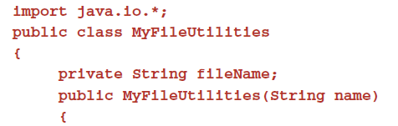
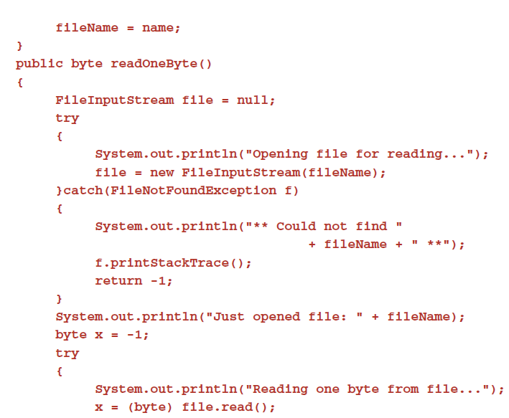
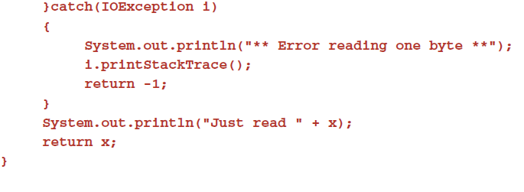
Writing Try/Catch Blocks

Slide 64
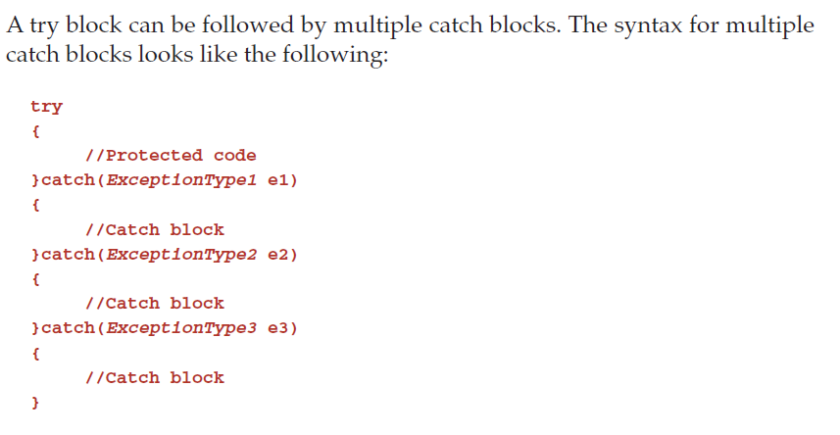
Writing Try/Catch Blocks
The code demonstrate three catch blocks, but you can have any number of them after a single try.
If an exception occurs in the protected code, the exception is thrown to the first catch block in the list.
If the data type of the exception thrown matches ExceptionType1, it gets caught there.
If not, the exception passes down to the second catch statement.
This continues until the exception either is caught or falls through all catches, in which case the current method stops execution and the exception is thrown down to the previous method on the call stack.
Notes:
With multiple catch blocks, the order in which the catch blocks are listed is the order they are checked when an exception occurs

Slide 65
Using throws clause
If you don’t want the exception to be handled in the same function you can use the throws class to handle the exception in the calling function.
public class myexception{
public static void main(String args[]){
try{
checkEx();
} catch(FileNotFoundException ex){
}
}
public void checkEx() throws FileNotFoundException{
File f = new File(“myfile”);
FileInputStream fis = new FileInputStream(f);
//continue processing here.
}
}
In this example, the main method calls the checkex() method and the checkex method tries to open a file, If the file in not available, then an exception is raised and passed to the main method, where it is handled.

Slide 66
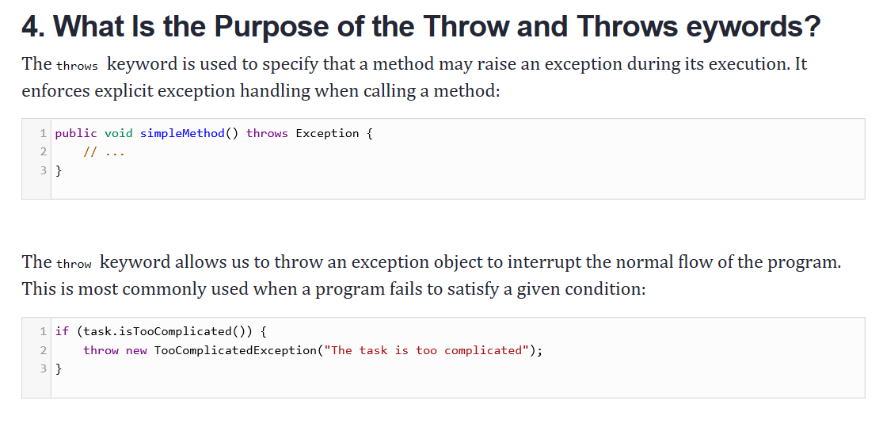
Using throws clause

Slide 67
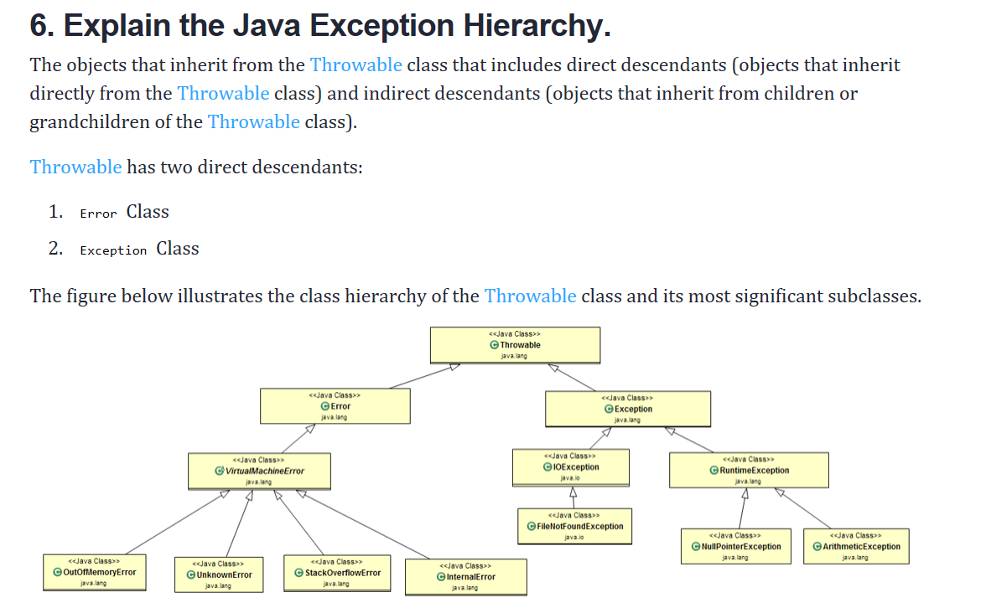
Exception Hierarchy

Slide 68
Creating Your Own Exception
In bigger applications, most of the cases we need custom exceptions for representing business exceptions are at a level higher than technical exceptions defined by the JDK.
Here are the steps that create a custom exception:
Create a new class whose name should end with an Exception, like the ClassNameException. This is a convention to differentiate an exception class from regular ones.
Make the class extends one of the exceptions that are subtypes of the java.lang.Exception class. Generally, a custom exception class always extends directly from the Exception class.
Create a constructor with a String parameter, which is the detail message of the exception. In this constructor, simply call the super constructor and pass the message.

Slide 69
Chained Exception
The chained exception feature allows you to associate another exception with an exception.
This second exception describes the cause of the first exception.
For example, imagine a situation in which a method throws an ArithmeticException because of an attempt to divide by zero.
However, the actual cause of the problem was that an I/O error occurred, which caused the divisor to be set improperly.
Although the method must certainly throw an ArithmeticException, since that is the error that occurred, you might also want to let the calling code know that the underlying cause was an I/O error.
Chained exceptions let you handle this, and any other situation in which layers of exceptions exist. This concept was introduced in JDK 1.4.

Slide 70
Preconditions and Postconditions
Preconditions and post-conditions are the states before and after a method’s execution Used to facilitate debugging and improve design
You should state the preconditions and post-conditions in a comment before the method declaration
Preconditions
  Condition that must be true when the method is invoked
  Describe method parameters and any other expectations the method has about the current state of a program
  If preconditions not met, method’s behavior is undefined
Postconditions
  Condition that is true after the method successfully returns
  Describe the return value and any other side-effects the method may have
  When calling a method, you may assume that a method fulfills all of its postconditions

Slide 71
Assertions
Assertions are conditions that should be true at a particular point in a method
Help ensure a program’s validity by catching potential bugs
Pre-conditions and Post-conditions are two kinds of assertions
Assertions can be stated as comments or assertions can be validated programmatically using the assert statement

Slide 72
13.13 Assertions
assert statement
  Evaluates a boolean expression and determines whether it is true or false
  Two forms
    assert expression; -- AssertionError is thrown if expression is false
    assert expression1 : expression2; -- AssertionError is thrown if expression1 is false, expression2 is error message
  Used to verify intermediate states to ensure code is working correctly
  Used to implement preconditions and postconditions programmatically
By default, assertions are disabled
Assertions can be enabled with the –ea command-line option

Slide 73

Questions ?
You can contact me @
avadekkedhil@wilp.bits-pilani.ac.in
9881300394

